Slide 1
ARUS 280 HW #7
Bed and Sofa(Abram Room, 1927, 1:09)
The Extraordinary Adventures of Mr. West in the Land of the Bolsheviks (Lev Kuleshov, 1924, 1:14)The Strike (Sergei Eisenstein, 1924, 1:35)
Beumers’s History, 60–67
Ascher, chapter 4

Slide 2
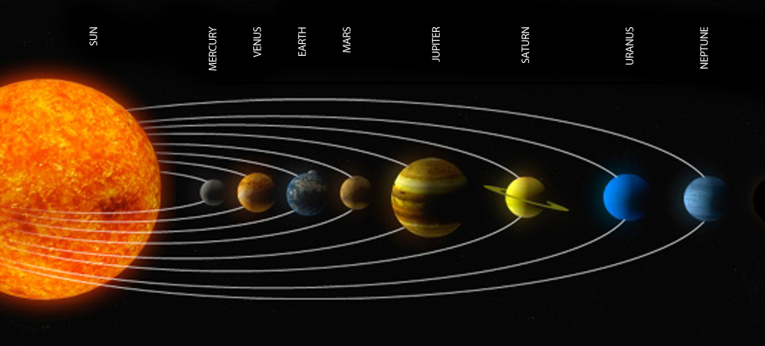
Beumers’s History, 60–67
Every paragraph all about married couple problems (summary don’t read else test)

Slide 3

pg 60
FEKS (1921), differen from Eisens film , based off comedy and acrobats, made by several ppl
1st film adventures of oktiabrina, a tax collector whos fighting w/ an NEP agent whos trying to colect taxes the new gov't has annulled
The Devils Wheel is about two ppl who meet each other during the civil war, then they run into gangsters and do their evil deeds till Vania gets them arrested
The Overcoat is about hows a guys life is ruined because he lost his coat and how he needs to find it again
DA DA DEE DO BOP
DAH DA DA DAH
DA DA DEE DOO BOP DO DOO DOO TADA

Slide 4
pg 62
Yakov Protozanov came back in 1923, he knew ppl tastes. Makes a film in 1924 about a guy who dreams abt going to mars kills his wife, free slaves falls in love w. princess aelita, n wakes up. He was critized because conquering planets was a bad thing.
His Call (1925) man goes back to his flat and befriends the residents in order to get the
DA DA DEE DO BOP
DAH DA DA DAH
DA DA DEE DOO BOP DO DOO DOO TADA
the treasure chest he befriends the ppl living there and gets it he also made
Films mocking soviet bureaucracy
Forty-first about a girl who falls in love but kills this general, he makes it as she lost morals instead of being an amry hero

Slide 5
pg 63
Three millions case (1926) couple get robbed by two thieves and become broke
The Bear’s wedding (1920) by Konstatin about a guy who mutilates a girl and her sister gets revenge,
Best melodrama Abram Room, he had a
DA DA DEE DO BOP
DAH DA DA DAH
DA DA DEE DOO BOP DO DOO DOO TADA
medical background, several documentaries made Death bay (1926) and Bed
and Sofa (1927) about a guy who moves in with his friend to sleep with his
wife, she eventually has a son and leaves them

Slide 6
pg 64-65
In that movie we find she just only male convenience and has no mind of her own
Liuda also didn’t want a child because she was poor
Outraged everyone she wasn’t a
DA DA DEE DO BOP
DAH DA DA DAH
DA DA DEE DOO BOP DO DOO DOO TADA
free Soviet woman
Miss Mend about American bandits who want to disease Russia, kidnaps someones boy, w/ the help of the police they kill the bandits
The Girl with a Hat Box,someone comes in to live have a fake marriage w/ someone, she gets kicked out but gets a lottery ticket and has a real marriage

Slide 7
pg 66-67
The house on Trubnaya Square about a girl who mistakenly gets called to office, but gets evicted. She gets justice with help
Fredrich Ermler sets us KEM w/ a partner and they copy FEKS
DA DA DEE DO BOP
DAH DA DA DAH
DA DA DEE DOO BOP DO DOO DOO TADA
Parisian Cobblerabout a girl who gets pregnant and everybody disowns however the political party Andrei in eventually kicks him
out although she doesn’t get justice we learn that people
in parties are not always good
Fragment of an Empire married couples aruge

Slide 8
Ascher ch 4
Every paragraph

Slide 9
pg 7 (pdf)
after peter the great death in 1725 russia was divided.
People were concerned about how to have fun.
Elizabeth of Anne was
DA DA DEE DO BOP
DAH DA DA DAH
DA DA DEE DOO BOP DO DOO DOO TADA
successor, her fiancee a clergyman died, she got pressure from ppl to sign things

Slide 10
pg 8 (pdf)
Elizabeth invited her nephew Peter to be heir, he knew German but changed in a year.
Then she got him married to Sophia Fredrich to keep the royal blood
DA DA DEE DO BOP
DAH DA DA DAH
DA DA DEE DOO BOP DO DOO DOO TADA
but they didnt like each other

Slide 11
pg 9 (pdf).
When Elizabeth died Peter ascended but he didn't do well
However he got things done. for the nobles they didn't have to do too much and let ppl go back home. there was peace during his reign
DA DA DEE DO BOP
DAH DA DA DAH
DA DA DEE DOO BOP DO DOO DOO TADA

Slide 12
pg 10 (pdf).
However he was acting too German and idolized Prussia too much.
He was always drunk and made fun of Catherine, no one liked him so while he was away Catherine made herself quen
DA DA DEE DO BOP
DAH DA DA DAH
DA DA DEE DOO BOP DO DOO DOO TADA

Slide 13
pg 11(pdf)
Catherine ran around w/ many men.
But she loved them and gave them riches,
DA DA DEE DO BOP
DAH DA DA DAH
DA DA DEE DOO BOP DO DOO DOO TADA

Slide 14
pg 12 (pdf)
She worked very hard also. said 'peace though conquer' was wrong
She won a lot of wars and annexed land to RUSSIA, ppl thought she was going too far.
As a result you got foreigners in Russia staging revolts
DA DA DEE DO BOP
DAH DA DA DAH
DA DA DEE DOO BOP DO DOO DOO TADA

Slide 15
pg 13 -14(pdf).
She supported the Enlightenment helped Denis Diderot w/ his French library.
She said Russia was the best place to live ... She wrote about other things too of social and history
DA DA DEE DO BOP
DAH DA DA DAH
DA DA DEE DOO BOP DO DOO DOO TADA
She wasn’t a good writer though
Ppl checked her claims but since she blessed them they didn't say anything bad
When reforming the gov't, comission so big the cldn't get anything done. Catherine was too conservative

Slide 16
pg 15 -16(pdf).
Catherine divided the empire into provnices, gov. Talked to empress
Charter of nobility -Nobles didn't have to worry abt crime and do things, but cldn't really gather to petition gov't
DA DA DEE DO BOP
DAH DA DA DAH
DA DA DEE DOO BOP DO DOO DOO TADA
Charter of towns- towns ruled by rich merchants who had no power
She shut down Emeilan Pugachev rebellion, who left the army cuz he was very sick.
They wanted him toutured but the queen just had him tried and executed.
Shows us how Russia was never about enlightment n peace although catherine was

Slide 17
pg 17-18 (pdf).
When she heard about the french revolution it drove her mad she cldnt trust anyone
Radischlev wrote russia was a bad corrupt place, They wanted to kill him but catherine sent him to exile
Her reign was a success but she
DA DA DEE DO BOP
DAH DA DA DAH
DA DA DEE DOO BOP DO DOO DOO TADA
Didn’t get along w/ her son paul, even though he was legitmate she failed to get her grandson alexander as king and the court was divided again
Paul was an argry guy, did opposite of her mom, helped peasants but exalted himself

Slide 18
pg 19 (pdf)
He said only guys can be king and king cant choose whoever to be ruler anymore.
He said serfs don’t work on sundays, but merchants can buy them led to uprisings
DA DA DEE DO BOP
DAH DA DA DAH
DA DA DEE DOO BOP DO DOO DOO TADA

Slide 19
The Extrordinary adventures of Mr.West in the land of the Bolsheviks
Every 5 min

Slide 20
5 min
(every paragraph or everything you noted in this frame , every page gets its own bullet point so delete this )
(duplicate this slide for more pages or clips by pressing [Ctrl-D])(delete this also)
DA DA DEE DO BOP
DAH DA DA DAH
DA DA DEE DOO BOP DO DOO DOO TADA

Slide 21
Bed and Sofa
Every 5 min

Slide 22
5 min
(every paragraph or everything you noted in this frame , every page gets its own bullet point so delete this )
(duplicate this slide for more pages or clips by pressing [Ctrl-D])(delete this also)
DA DA DEE DO BOP
DAH DA DA DAH
DA DA DEE DOO BOP DO DOO DOO TADA

